Slide 1

Amazon Web Services

Slide 2
Overview
What is Amazon?
What is AWS?
AWS Services
AWS Components
AWS Regions
Why AWS
How to access AWS services
AWS Free Tier
AWS training

Slide 3
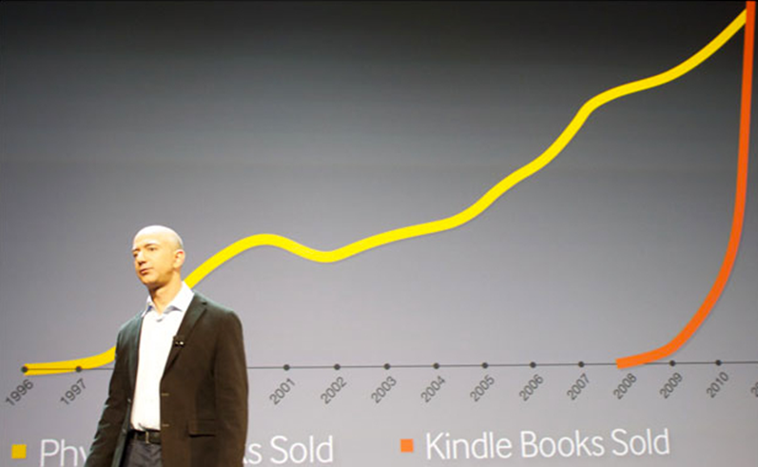
What is Amazon?
The world’s largest online retailer
Founded in 1994 by Jeff Bezos
Headquartered in Seattle, Washington
Had revenues of 48 billion in 2011
Did not show a profit until 2001

Slide 4
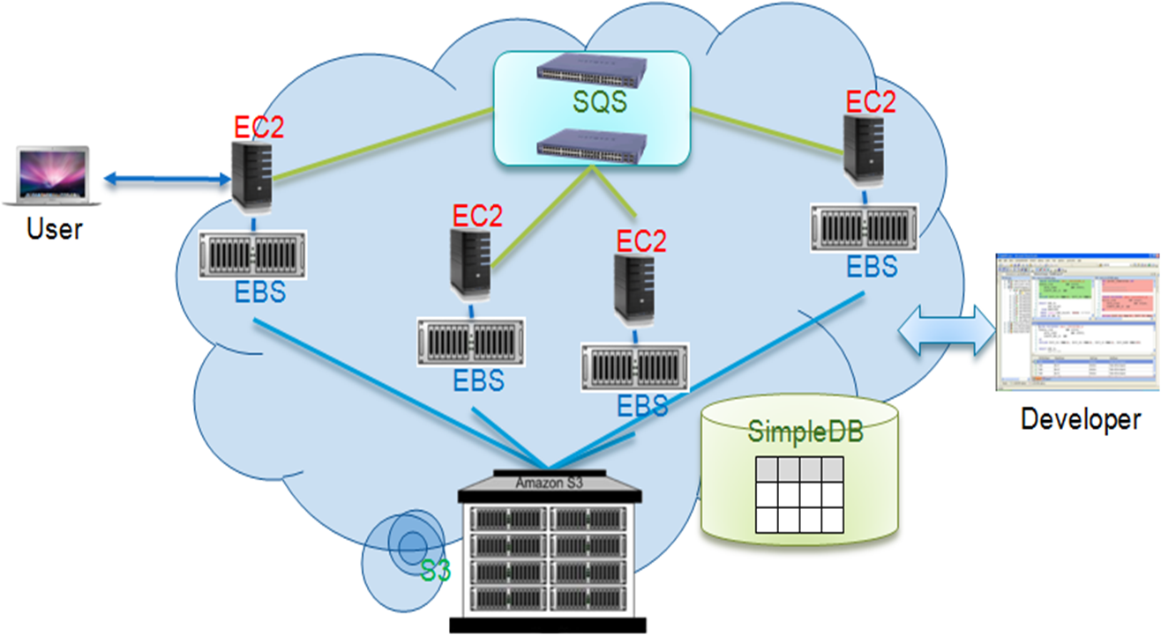
What is AWS?
AWS is Amazon’s umbrella description of all of their web-based technology services.
AWS offers cloud computing (SaaS, Paas, Iaas, Staas, Naas)
Main services offered by AWS:
Amazon Elastic Compute Cloud (EC2)
Amazon Simple Storage Service (S3)
Amazon Relational Database Service (RDS)
Amazon Elastic Block Storage (EBS)
Amazon Simple Queue Service (SQS)
Amazon Virtual Private Cloud (VPC)

Slide 5
AWS Services
Compute
Scale to meet your application demands, whether one server or a larger cluster. Choose from 10+ instance sizes and a variety of operating systems.
e.g. Amazon Elastic Compute Cloud (EC2)
Storage
Utilize cost-effective solutions for storing and retrieving any amount of data, anytime and anywhere.
e.g. Amazon Simple Storage Service (S3)
Database
Leverage scalable database solutions, from managed MySQL or Oracle, hosted enterprise database software, or non relational database solutions.
e.g. Amazon Relational Database Service (RDS)
Networking
Customize and control your network resources, both inside and outside the cloud.
e.g. Amazon Virtual Private Cloud (VPC)

Slide 6
AWS Components
Instance – store : disappears with the instance (transient)
Block storage: SAN-like, persists across time
S3 is independent of an instance: for archival purposes: vault: store it now and retrieve it at a later date
Amazon: SimpleDB: Relational database better than MySQL or Oracle for reliability.

Slide 7
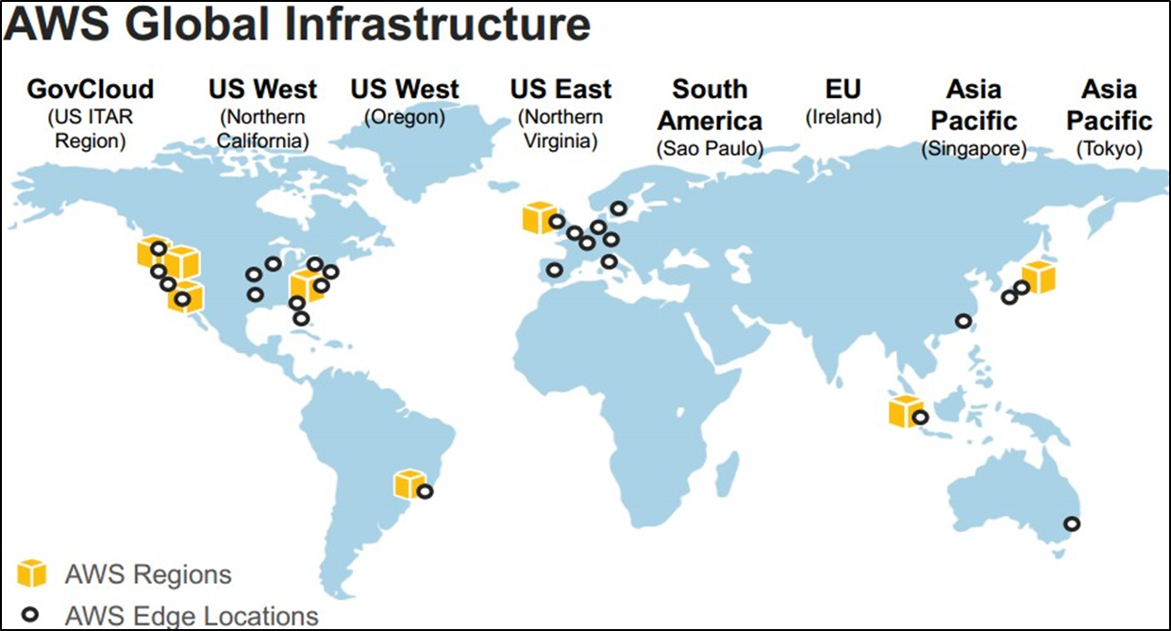
AWS Regions 11 regions, 28 availability zones (1 to 6 data centers)… 1.4 million servers worldwide!!

Slide 8
Why AWS?
Low Cost
Pay-as-you go, no upfront expenses or long-term commitments.
Instant Elasticity
Instantly deploy your applications. Scale resources up or down based on demand.
Open and Flexible
If it runs in a data center, it can run on AWS. You have full control.
Secure
Utilize a secure technology platform built and managed by Amazon.

Slide 9
How to access AWS services (EC2, RDS, S3, VPC, SQS, EBS, SimpleDB)
AWS console
http://console.aws.amazon.com
The ElasticFox firefox plugin
The amazon command line tool

Slide 10
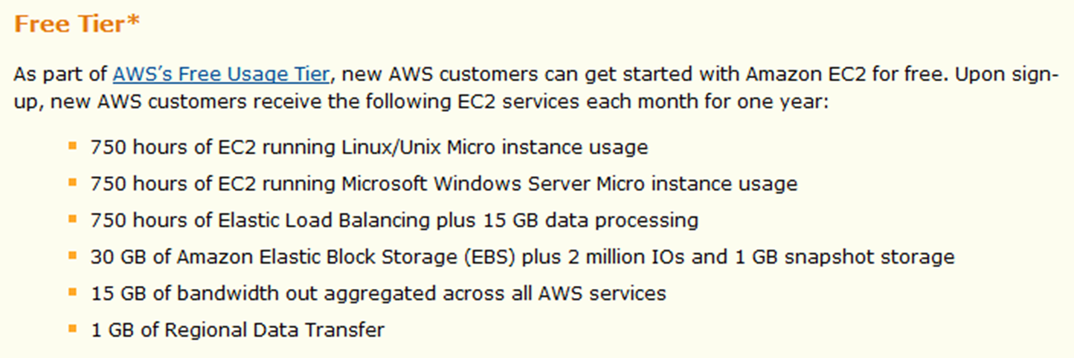
AWS Free Tier

Slide 11
AWS training
Go to https://www.aws.training/

